Slide 1
Capstone Project: Predictive Modelling for COVID-19 in Public Health
Presented
by
Amos James
FE/23/72671845
Cohort 2
Data Science
PLATEAU STATE

Slide 2
COVID-19 Pandemic Analysis Report
Introduction
This project investigates the spread of the COVID-19 pandemic by analyzing data on cases, deaths, and recoveries across different regions and countries. The primary objectives are to understand the progression of the pandemic, visualize trends, and predict future outcomes using machine learning techniques.

Slide 3
Project Goals
Understand Spread: Examine how COVID-19 propagated over time globally and regionally.
Data Analysis: Assess cumulative data for confirmed cases, deaths, and recoveries.
Data Visualization: Highlight patterns in the distribution of cases, recoveries, and deaths.
Prediction: Employ machine-learning models to forecast future trends, including potential increases in cases and deaths.

Slide 4
Data Overview
The dataset includes the following features:
Lat (Latitude): Geographical location (north/south).
Long (Longitude): Geographical location (east/west).
Date: Daily reporting date.
Confirmed: Cumulative confirmed cases.
Deaths: Cumulative deaths.
Recovered: Cumulative recoveries.
Active: Ongoing cases.
WHO Region: Region categorized by the World Health Organization.

Slide 5
Sample Data Structure
Geographic Data:
Examples include Afghanistan, Albania, Algeria, Andorra, and Angola.
Daily Confirmed Cases:
Initial data: 555 confirmed cases on 2020-01-22.
Peak period (as of sample): Over 16 million cases by 2020-07-27.
Country-level Snapshot:
US: 4,290,259 confirmed cases.
Brazil: 2,442,375 confirmed cases.
India: 1,480,073 confirmed cases.

Slide 6
Analysis Approach
Trend Analysis:
Use cumulative data to plot progression over time.
Compare regions to identify patterns.
Visualization:
Employ graphs and maps to illustrate global spread.
Highlight regions with significant increases or decreases.
Prediction:
Apply machine learning to historical data for forecasting.
Evaluate the model's accuracy for predicting cases or deaths.

Slide 7
Confirmed Cases
S/N | Date | Confirmed
0 | 2020-01-22 | 555
1 | 2020-01-23 | 654
2 | 2020-01-24 | 941
3 | 2020-01-25 | 1434
4 | 2020-01-26 | 2118
... | ... | ...
183 | 2020-07-23 | 15510481
184 | 2020-07-24 | 15791645
185 | 2020-07-25 | 16047190
186 | 2020-07-26 | 16251796
187 | 2020-07-27 | 16480485

Slide 8
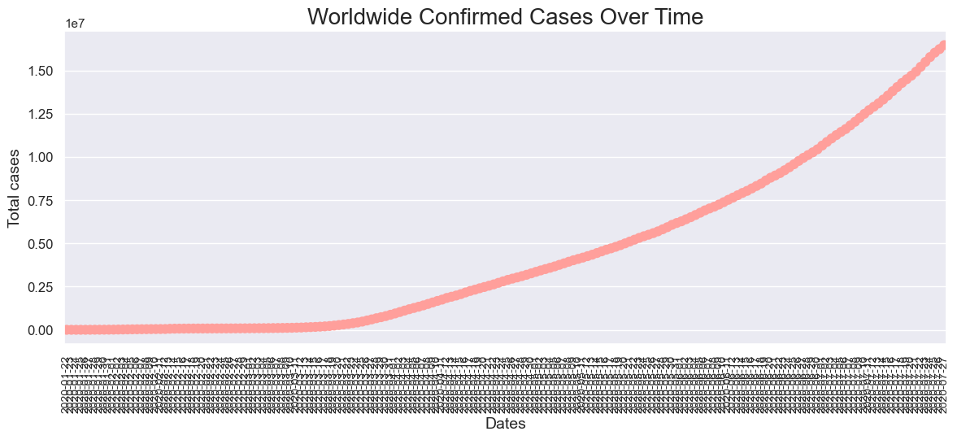

Slide 9
S/N | Country/Region | Confirmed
0 | US | 4290259
1 | Brazil | 2442375
2 | India | 1480073
3 | Russia | 816680
4 | South Africa | 452529
5 | Mexico | 395489
6 | Peru | 389717
7 | Chile | 347923
8 | United Kingdom | 301708
9 | Iran | 293606

Slide 10
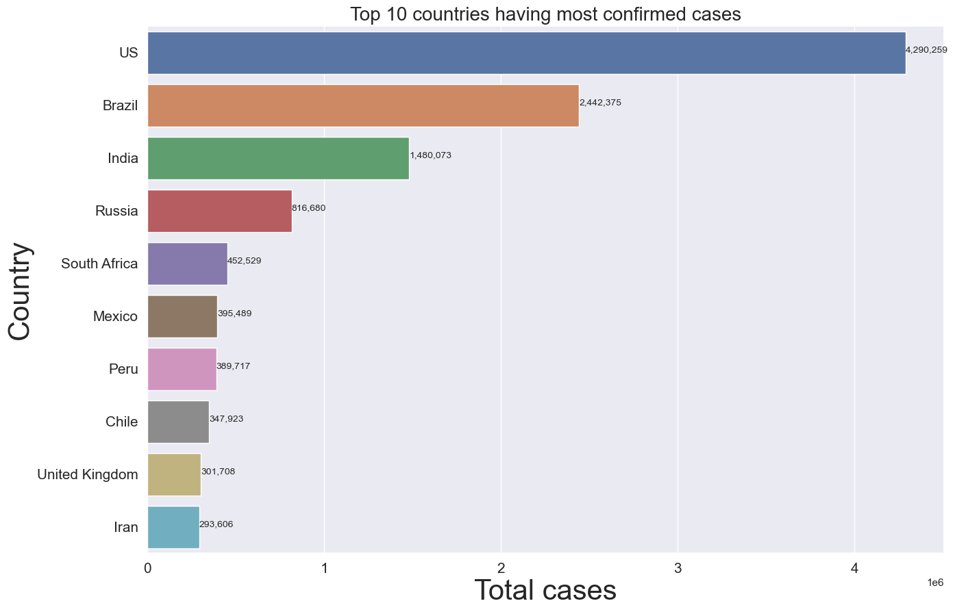

Slide 11
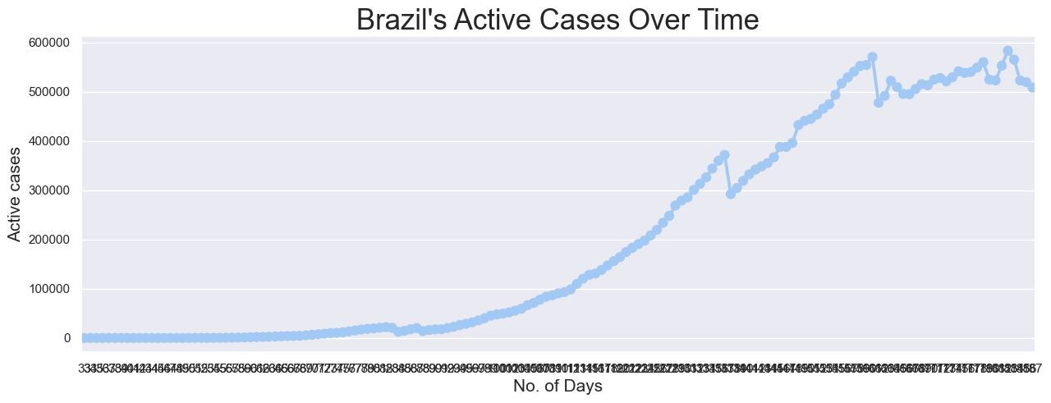

Slide 12
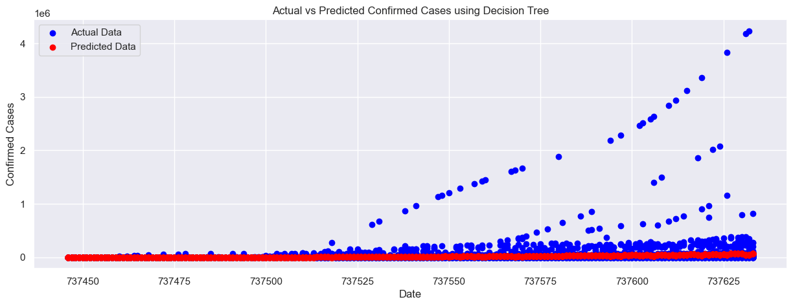

Slide 13
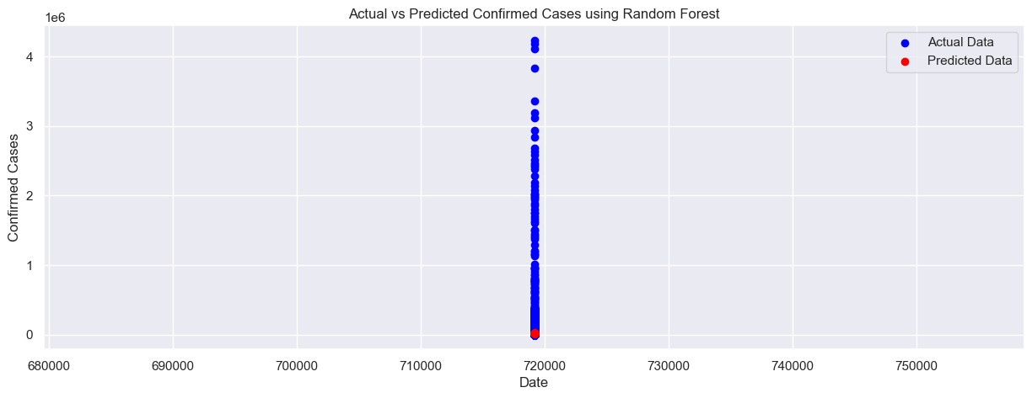

Slide 14
Next Steps
Data Cleaning: Address missing or inconsistent values.
Model Training: Train predictive models using a portion of the data.
Validation: Test and refine models for better accuracy.
Interpretation: Extract actionable insights from results.
This report outlines the groundwork for understanding and combating COVID-19, combining historical analysis with predictive modeling to aid public health decisions.

